Slide 1
Lecture 8: creating animations in R
Trevor A. Branch
tbranch@uw.edu
Beautiful graphics in R, FISH507H
SAFS, University of Washington

Slide 2
Hans Rosling
200 countries and 200 years in four minutes
http://www.youtube.com/watch?v=jbkSRLYSojo

Slide 3
Animation
Takes longer to understand data
But more engaging
More multi-dimensional
Fisher D (2010) Animation for visualization: opportunities and drawbacks. pp 329-352 in J. Steele and
N. Iliinsky, editors. Data visualization: looking at data through the eyes of experts. O'Reilly, Beijing.

Slide 4
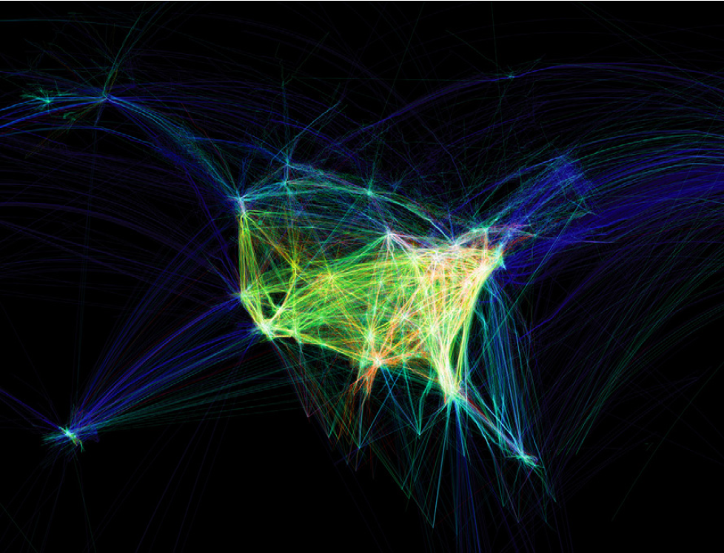
Flights arriving at and departing from the U.S.
Koblin A & Klump V (2010) Flight patterns: a deep dive. pp 91-102 in J. Steele and N. Iliinsky, editors.
Data visualization: looking at data through the eyes of experts. O'Reilly, Beijing

Slide 5
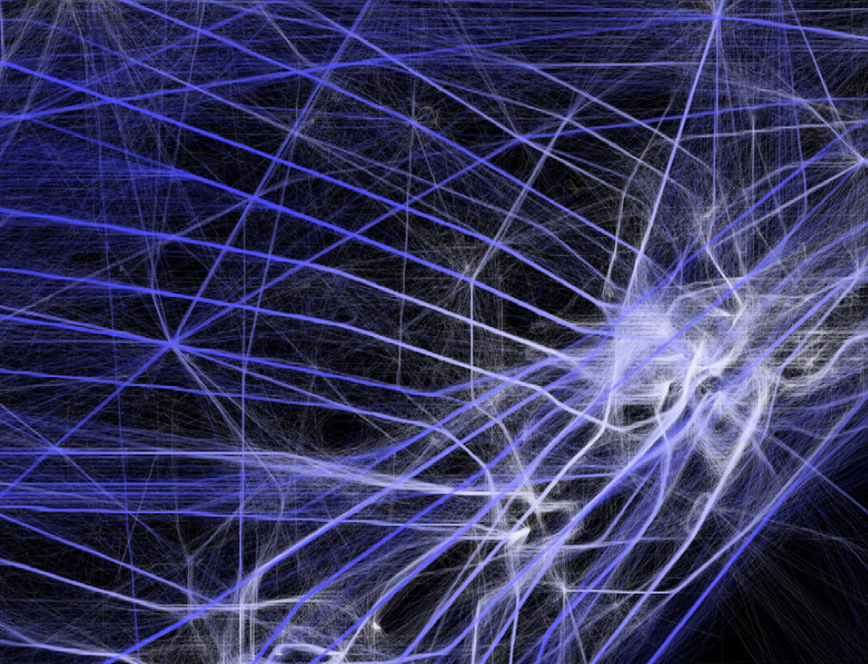
Koblin A & Klump V (2010) Flight patterns: a deep dive. pp 91-102 in J. Steele and N. Iliinsky, editors.
Data visualization: looking at data through the eyes of experts. O'Reilly, Beijing

Slide 6
Data plotted: August 12–13, 2008, includes 205,514 flights, sampled every minute, for a total of 26,552,304 data points
http://users.design.ucla.edu/~akoblin/work/faa/color.html
http://www.aaronkoblin.com/work/flightpatterns/FPWeb_Final_3.mov

Slide 7
Global ocean health index
http://www.oceanhealthindex.org/

Slide 8
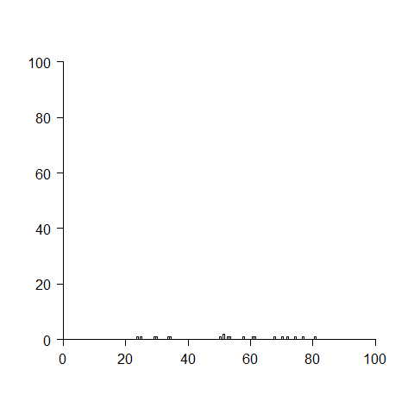
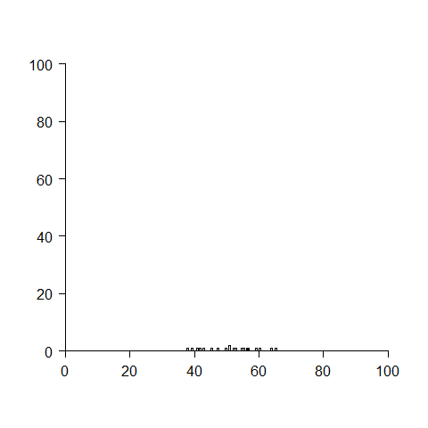
Central limit theorem
“ the mean of a sufficiently large number of independent random variables, each with finite mean and variance, will be approximately normally distributed”
4000 draws of 3 numbers from U[0,100]
distribution of means plotted
4000 draws of 10 numbers from U[0,100]
distribution of means plotted

Slide 9
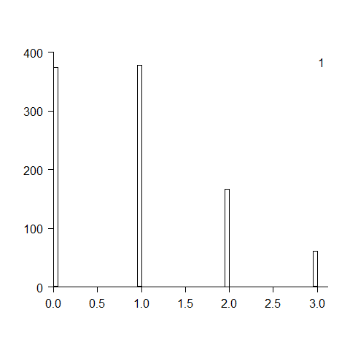
Exercise 1: 1000 means from a Poisson(lambda=1) distribution
means of 1,2,3,…,100 samples

Slide 10
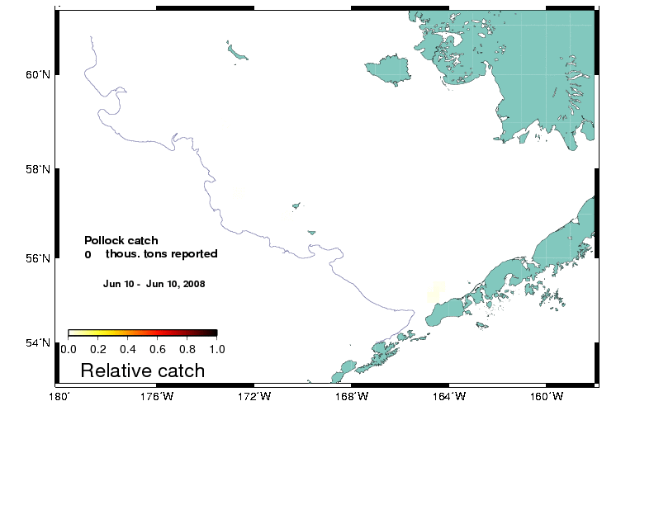


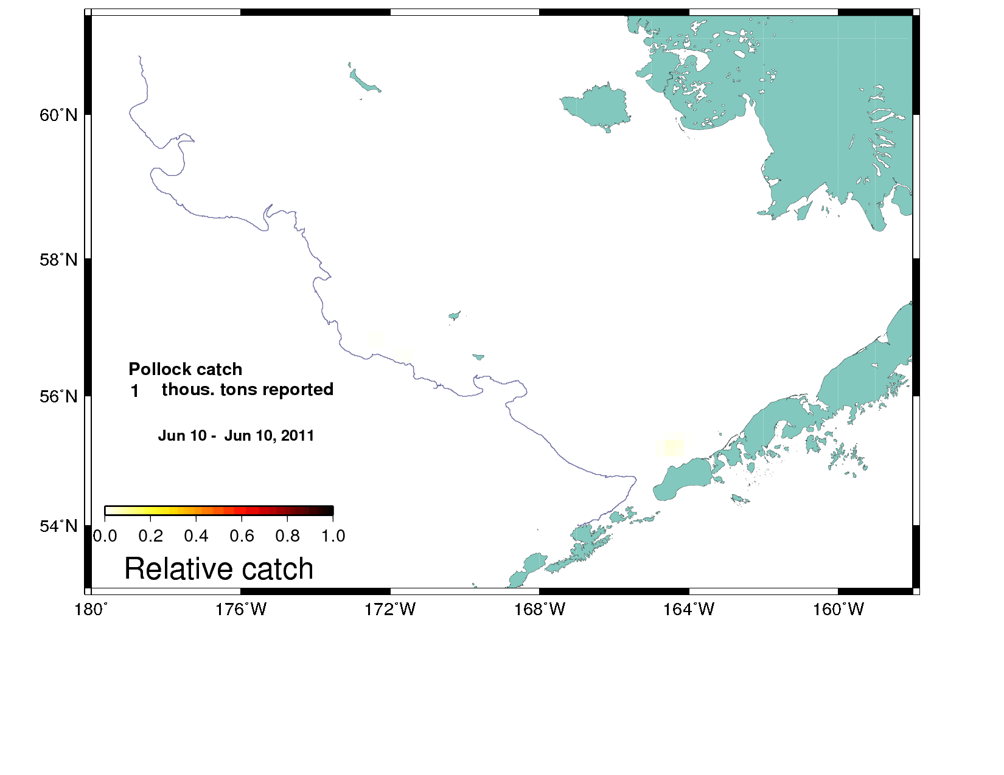
Observed fishery catch patterns—summer
Scientific fishery observers monitor in-season catch to ensure catch<TAC
2008
2010
2009
2011
Notes:
Slide courtesy of Jim Ianelli. Made using ImageMagick and gifsicle from a command prompt (type “cmd” in search) with these commands:
convert -density 92 -delay 100 -rotate 90 @roefiles.dat roe_an.gif
where rowfiles.dat just an ascii file listing postscript images to be put into roe_an.gif.
The gifsicle command (compresses) was:
gifsicle --colors 256 -b -O2 roe_an.gif

Slide 11
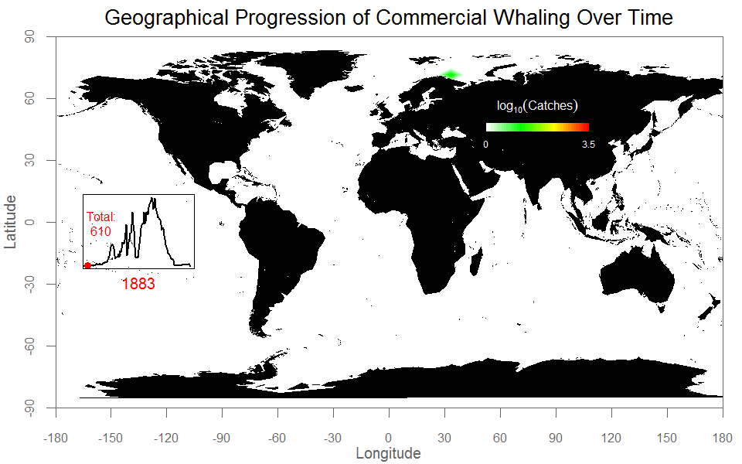
Creator: Cole Monnahan
Data: International Whaling Commission

Slide 12
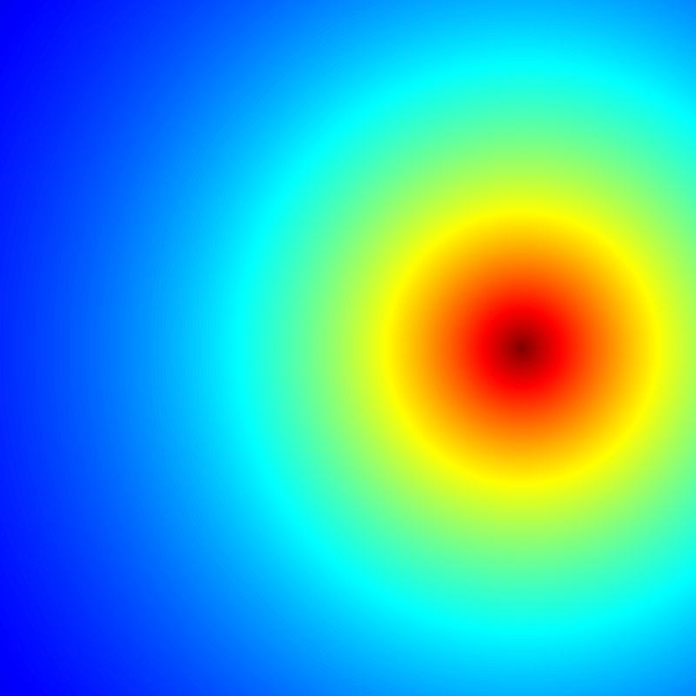
Notes:
jet.colors = colorRampPalette(c("#00007F", "blue", "#007FFF", "cyan", "#7FFF7F",
"yellow", "#FF7F00", "red", "#7F0000")) # define "jet" palette
m = 400
C = complex( real=rep(seq(-1.8,0.6, length.out=m), each=m ),
imag=rep(seq(-1.2,1.2, length.out=m), m ) )
C = matrix(C,m,m)
Z = 0
X = array(0, c(m,m,20))
for (k in 1:20) {
Z = Z^2+C
X[,,k] = exp(-abs(Z))
}
image(X[,,k], col=jet.colors(256))
write.gif(X, "Figs\\Mandelbrot.gif", col=jet.colors, delay=100)

Slide 13
The Mandelbrot set
http://www.youtube.com/watch?v=WAJE35wX1nQ
http://www.youtube.com/watch?v=G_GBwuYuOOs
Repeat this infinite times (n→∞)
If the function Z does not go to infinity, then c is in the Mandelbrot set
(Complication: c is a complex number)
Color related to number of iterations n.
More details: http://warp.povusers.org/Mandelbrot/

